Slide 1

Dominos - Predictive Purchase Order System
By
Gengatharan L

Slide 2
Dominos wants to optimize the process of ordering ingredients by predicting future sales and creating a purchase order.
By accurately forecasting sales, Dominos can ensure that it has the right amount of ingredients in stock, minimizing waste and preventing stockouts.
This project aims to leverage historical sales data and ingredient information to develop a predictive model and generate an efficient purchase order system.
Problem Statement

Slide 3
Accurate Sales Prediction: Develop a accurate predictive model to forecast future sales based on historical sales data and trends.
Efficient Ingredient Ordering: Prepare a purchase order system that aligns with predicted sales of Pizzas to ensure an optimal inventory level.
Waste Reduction: Minimize ingredient wastage by avoiding overstocking and managing inventory efficiently.
Cost Optimization: Reduce costs associated with excess inventory, storage, and expired ingredients.
Objectives

Slide 4
Sales Data: Historical sales records (Date, Pizza Type, Quantity Sold, Price, Category, Ingredients)
Ingredient Data: Ingredient requirements for each pizza type (Pizza Type, Ingredient, Quantity Needed)
Pizza_Sale.csv with 48,620 rows and 12 columns.
Pizza_Ingredients.csv with 518 rows and 4 columns.
On average, a Domino's store in US sells about 400 pizzas per day. Domino's US sells over 4 million pizzas per month.
Dataset Overview

Slide 5
Based on the pattern in Pizza sales, predicted the future sales using advanced Machine learning techniques. Based on the forecasted Pizza sales, ingredients-oriented purchase order is created.
The complete strategy of analysis as follows:
Data Preprocessing
Exploratory Data Analysis (EDA)
Feature Engineering
Model Selection
Model Training and Evaluation
Sales Forecasting
Ingredient Calculation
Purchase Order Generation
Project Overview

Slide 6
Data Preprocessing and Exploration
Data Cleaning: Remove any missing or inconsistent data entries, handle outliers, and format the data appropriately.
Exploratory Data Analysis (EDA): Analyze sales trends, seasonality, and patterns in the historical sales data. Visualize the data to identify significant features.
Sales Prediction
Feature Engineering: Create relevant features from the sales data, such as day of the week, month, promotional periods, and holiday effects.
Model Selection: Choose an appropriate time series forecasting model (e.g., ARIMA, SARIMA, Prophet, LSTM, Regression Model).
Model Training: Train the predictive model on the historical sales data.
Model Evaluation: Use metric Mean Absolute Percentage Error (MAPE) to evaluate model performance.
Purchase Order Generation
Sales Forecasting: Predict pizza sales for the next one week (your choice of months or weeks) using the trained model.
Ingredient Calculation: Calculate the required quantities of each ingredient based on the predicted sales and the ingredient dataset.
Purchase Order Creation: Generate a detailed purchase order listing the quantities of each ingredient needed for the predicted sales period.
Approach

Slide 7
Data Preprocessing
Column_name Qty
pizza_id 0
order_id 0
pizza_name_id 16
quantity 0
order_date 0
order_time 0
unit_price 0
total_price 7
pizza_size 0
pizza_category 23
pizza_ingredients 13
pizza_name 7
Step 1: Load Pizza sales and ingredients excel files and read with pandas
Step 2: Pizza sales dataset
The dataset was analyzed using functions like head(), shape, and info()
to understand its structure.
Missing values were identified using Sales_df.isnull().sum(),
with a focus on key columns such as unit_price, quantity, total_price,
pizza_category, pizza_ingredients, pizza_name, and pizza_name_id.
Step 3: Pizza ingredients dataset
Check null values in the Pizza ingredients: Ingredients_df.isnull().sum()
Fill null values in items_Qty in Grams values were filled
using the mean quantity for each pizza_name_id,
calculated using the groupby and mean methods.
Column_name Qty
pizza_name_id 0
pizza_name 0
pizza_ingredients 0
Items_Qty_In_Grams 4

Slide 8
Step 4: Mapping the Pizza Sales and Ingredients
Fill null values in Pizza Categories Based on Pizza Name ID (Mapping Pizza Name ID to Fill missing values of Pizza Category)
Fill null values in Pizza Ingredients Based on Pizza Name (Mapping Pizza Name to Fill Pizza Ingredients)
Fil null values in Missing Pizza Name Based on Pizza Ingredients (Mapping Pizza Ingredients to Fill Pizza Name)
Fill null values in Missing Pizza Name ID Based on Pizza Name (Mapping Pizza Name to Fill Pizza Name ID)
Step 5: Merged Pizza_Sales and Ingredients DataFrames
Two datasets were merged on pizza_name_id using a left join, ensuring all sales data was retained. Columns with duplicate or redundant data (pizza_ingredients_y and pizza_name_y) were dropped, and relevant columns were renamed for consistency.
Duplicate rows in the merged dataset were identified and removed using drop_duplicates(), reducing the dataset size and ensuring data integrity. A copy was created when removing outliers to avoid altering the original DataFrame unintentionally.

Slide 9
Date Parsing and Feature Extraction:
The order_date column was converted into a standardized date-time format using a custom function to handle multiple formats. New features were extracted from order_date, including day_of_week, month, week, and year, to enable time-based analysis.
Holiday and Weekend Promotion Flags:
A holiday indicator was added using the holidays library to mark US public holidays. A weekend promotion flag was created by checking if the order occurred on a weekend, aiding in promotional and sales trend analysis.
Daily Sales Aggregation:
The dataset was grouped by order_date to calculate the total quantity sold each day, providing insights into daily sales trends.
Feature Engineering

Slide 10
Outlier Detection and Removal:
Outliers in the quantity and total_price columns were identified using the Interquartile Range (IQR) method. Box plots were created for visualization, and rows with outliers were removed to ensure clean data.
Data Type Classification:
Columns were categorized into numerical and categorical types. Statistical measures such as mean, median, mode, standard deviation, and variance were calculated for selected numerical columns (quantity, unit_price, total_price).
Correlation Analysis:
A correlation matrix was computed for numerical columns to explore relationships between variables. A heatmap visualized the correlation, aiding in identifying strongly related features for further analysis.
Feature Engineering

Slide 11
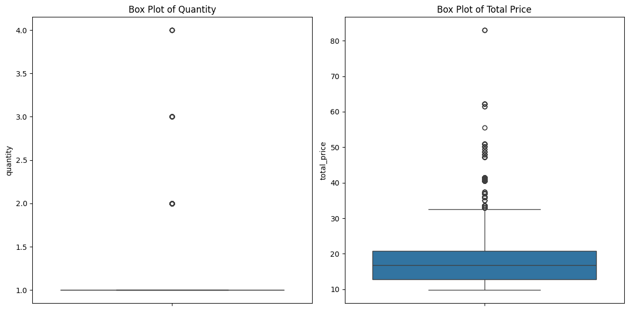
Exploratory Data Analysis
i) Outlier Detection:
Generate box plots for quantity and total_price columns to visualize the distribution and potential outliers in the data. The plots will help in identifying any extreme values that can be addressed by removing outliers based on the IQR method.

Slide 12
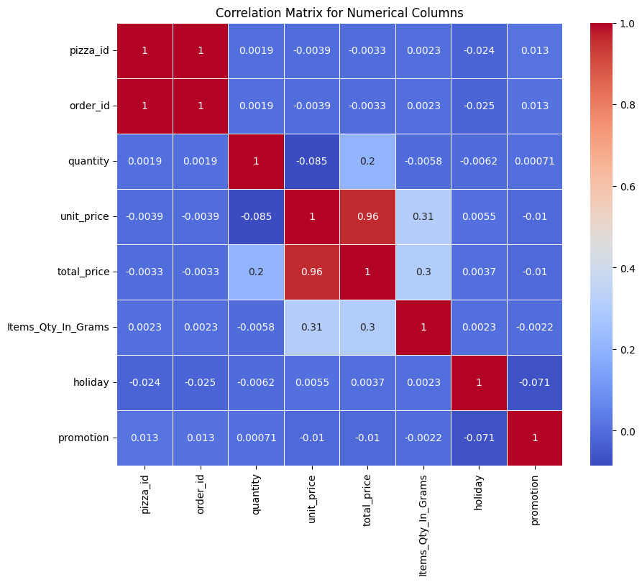
Exploratory Data Analysis
ii) Correlation Analysis:
Generate a heat map provides a visual representation of how different numerical variables are related to each other, where the colors represent the strength of the correlation (positive or negative).

Slide 13
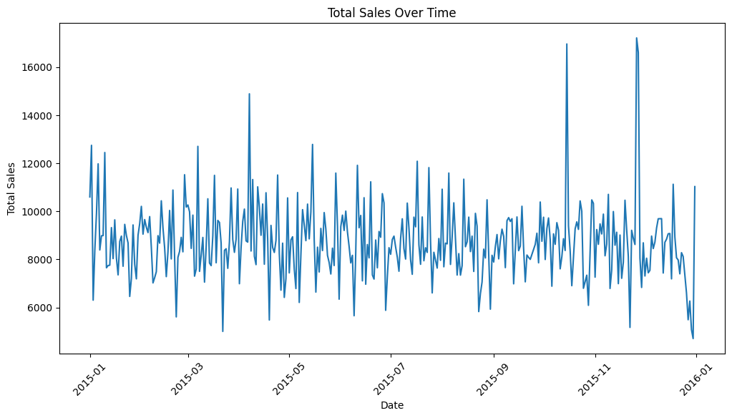
Exploratory Data Analysis
iii) Sales trend analysis over time:
Total sales were aggregated by order_date to analyze sales performance over time. A line plot was created to display the trend of total_price over time, providing insights into fluctuations and patterns in sales.

Slide 14
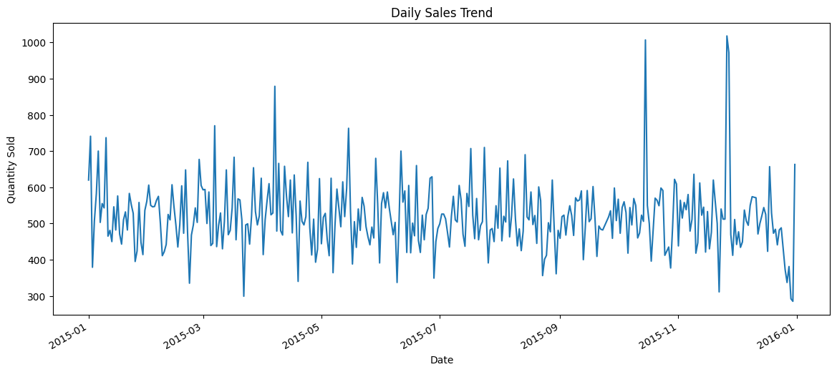
Exploratory Data Analysis
iv) Sales quantity over time:
Analyzes daily sales trends by plotting the total quantity sold per day using a time series line graph.

Slide 15
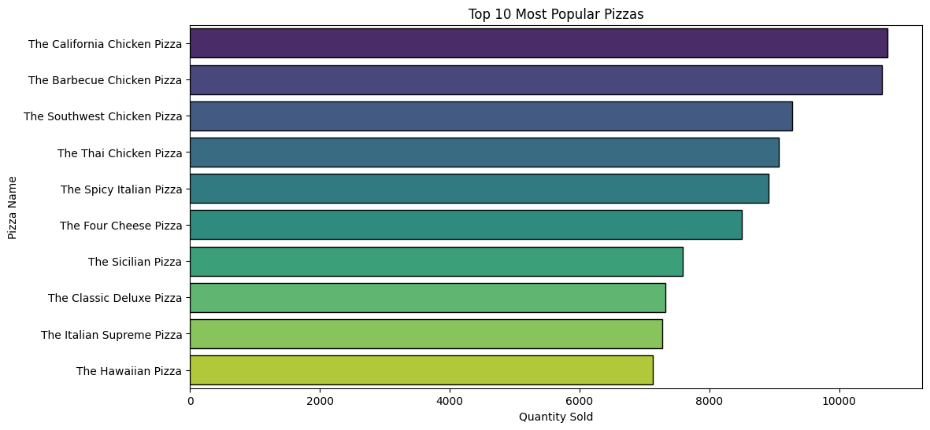
Exploratory Data Analysis
v) Top selling pizzas by quantity sold:
Aggregates pizza sales by name, sorts them by quantity sold, and visualizes the most popular pizzas with a bar plot.
Top 10 Most Popular Pizzas:
pizza_name quantity
4 The California Chicken Pizza 10740
0 The Barbecue Chicken Pizza 10662
25 The Southwest Chicken Pizza 9275
30 The Thai Chicken Pizza 9072
26 The Spicy Italian Pizza 8916
9 The Four Cheese Pizza 8494
23 The Sicilian Pizza 7592
7 The Classic Deluxe Pizza 7320
14 The Italian Supreme Pizza 7272
12 The Hawaiian Pizza 7131

Slide 16
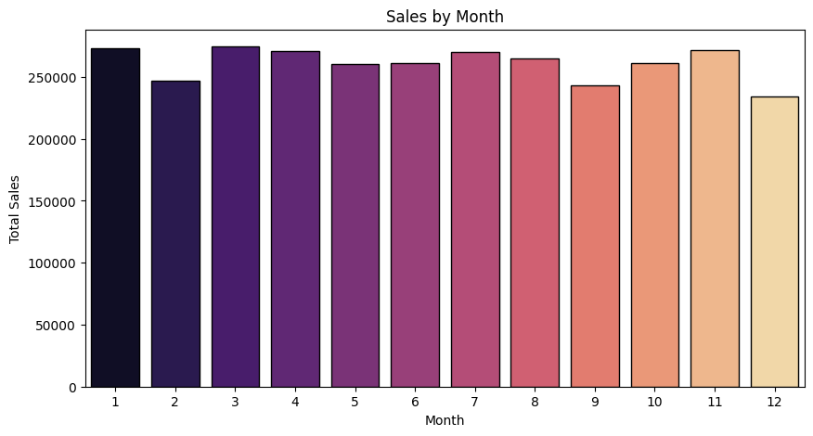
Exploratory Data Analysis
vi) Monthly sales trend analysis:
Aggregates total sales by month, visualizes the sales trend using a bar plot and prints the top 10 months with the highest sales.
month total_price
0 1 273426.45
1 2 246868.40
2 3 274623.55
3 4 270811.85
4 5 260803.90
5 6 261484.95
6 7 270133.65
7 8 265296.60
8 9 243481.85
9 10 261314.30

Slide 17
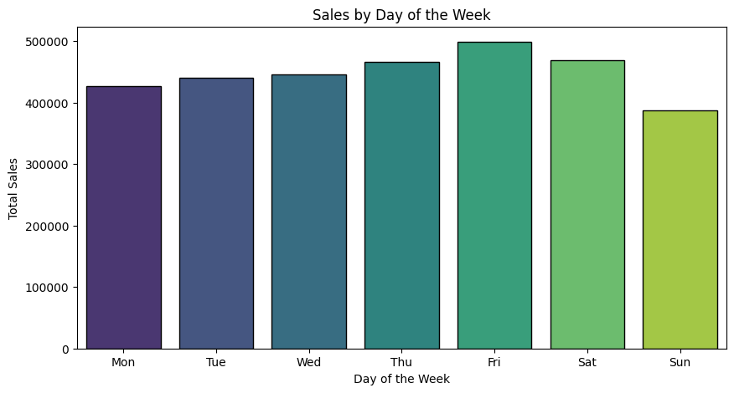
Exploratory Data Analysis
vii) Weekly sales trend analysis:
Aggregates total sales by day of the week, plots the sales trend, and labels the days from Monday to Sunday.
day_of_week total_price
0 0 426548.95
1 1 439749.70
2 2 446475.55
3 3 466306.55
4 4 498787.40
5 5 468262.80
6 6 387981.30

Slide 18
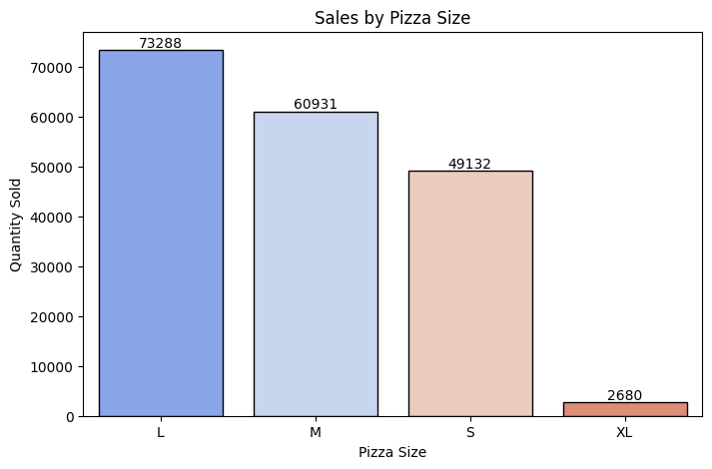
Exploratory Data Analysis
viii) Pizza Sales by size:
Aggregates the sales data by pizza size and then creates a bar plot to visualize the quantity sold for each pizza size.
pizza_size quantity
0 L 73288
1 M 60931
2 S 49132
3 XL 2680

Slide 19
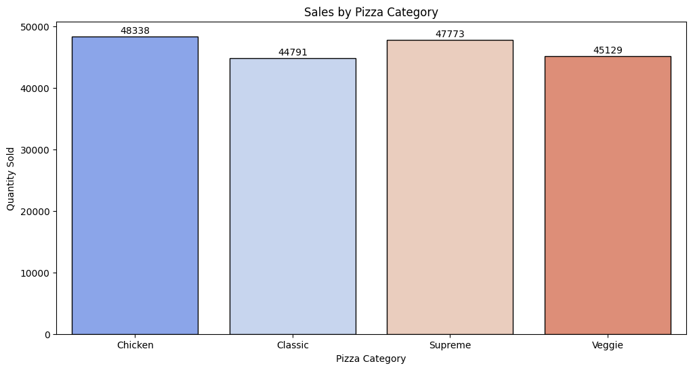
Exploratory Data Analysis
ix) Sales by Pizza Category:
Generate a bar plot showing the distribution of pizza sales by category. It groups the sales by the pizza_category and sums the quantity sold for each category.
pizza_category quantity
0 Chicken 48338
1 Classic 44791
2 Supreme 47773
3 Veggie 45129

Slide 20
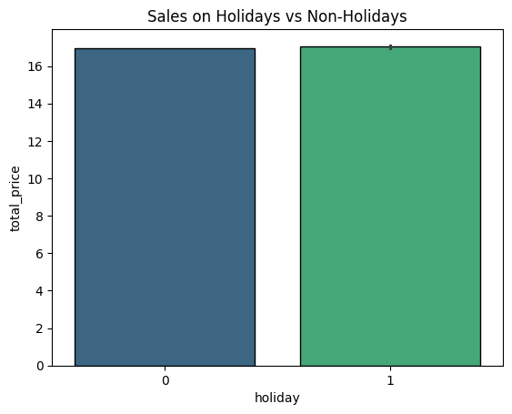
Exploratory Data Analysis
x) Sales on holidays vs non-holidays:
The sales data for holidays and non-holidays by grouping the data based on the holiday column and summing the total_price for each category.
Sales by Holiday vs Non-Holiday:
holiday total_price
0 0 3040306.85
1 1 93805.40

Slide 21
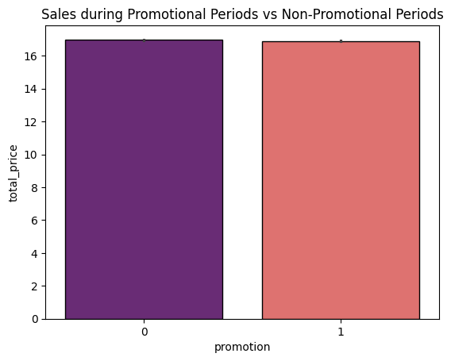
Exploratory Data Analysis
xi) Sales by Promotional Periods:
The total sales count during promotional and non-promotional periods, you can aggregate the data by the promotion column and sum the total_price.
Sales by Promotional Periods:
promotion total_price
0 0 2277868.15
1 1 856244.10

Slide 22
Model Development
ARIMA Model:
p (AutoRegressive term): The number of past observations (lags) used to predict the future value.
Example: If p=2, the model uses the last 2 observations to predict the next value.
d (Differencing term): The number of times the data is differenced to make it stationary.
Example: If your data has an upward trend, applying first-order differencing (d=1) can stabilize it.
q (Moving Average term): The number of past forecast errors used to improve future predictions. Models the dependency between the residual errors and lagged errors.
Implementation:
Step 1: Prepare Weekly Sales Data
Converted order_date to a datetime format. Aggregated sales data to a weekly frequency using groupby on order_date.
This resulted in a time series dataset (pizza_sales_weekly) where each row represents total weekly sales.
Step 2: Train-Test Split
Split the weekly sales data into train (80%) and test (20%) sets to evaluate model performance.

Slide 23
Step 3: Define MAPE (Mean Absolute Percentage Error)
Defined a custom function mape() to evaluate prediction accuracy.
MAPE is the percentage-based error metric to assess how far predictions deviate from actual values.
Step 4: ARIMA Model Tuning
Performed grid search on ARIMA parameters p, d, q to find the optimal model.
Iterated through combinations of orders(p, d, q) within the ranges: (range(0, 5), range(0, 2), range(0, 5))
For each combination:
Fitted the ARIMA model on training data. Forecasted weekly sales for the test set.
Calculated MAPE to evaluate model performance.
Selected the best model with the lowest MAPE.
Step 5: Predictions and Best Parameters
The best ARIMA parameters (4, 1, 0) were displayed along with their corresponding MAPE score (0.1991). Forecasted weekly sales on the test data using the best ARIMA model.

Slide 24
Steps for Tuning Parameters:
Make the Data Stationary:
Plot the time series to observe trends or seasonality.
Use ADF (Augmented Dickey-Fuller) or KPSS tests to check stationarity.
If the data is non-stationary, apply differencing (d=1 or d=2) until it becomes stationary.
Set the Initial Parameters:
Use Autocorrelation Function (ACF) and Partial Autocorrelation Function (PACF) plots:
p: Determined by the PACF plot (number of significant lags).
q: Determined by the ACF plot (number of significant lags).
Grid Search for Optimal Parameters:
Perform a grid search over a range of p,d,q values.

Slide 25
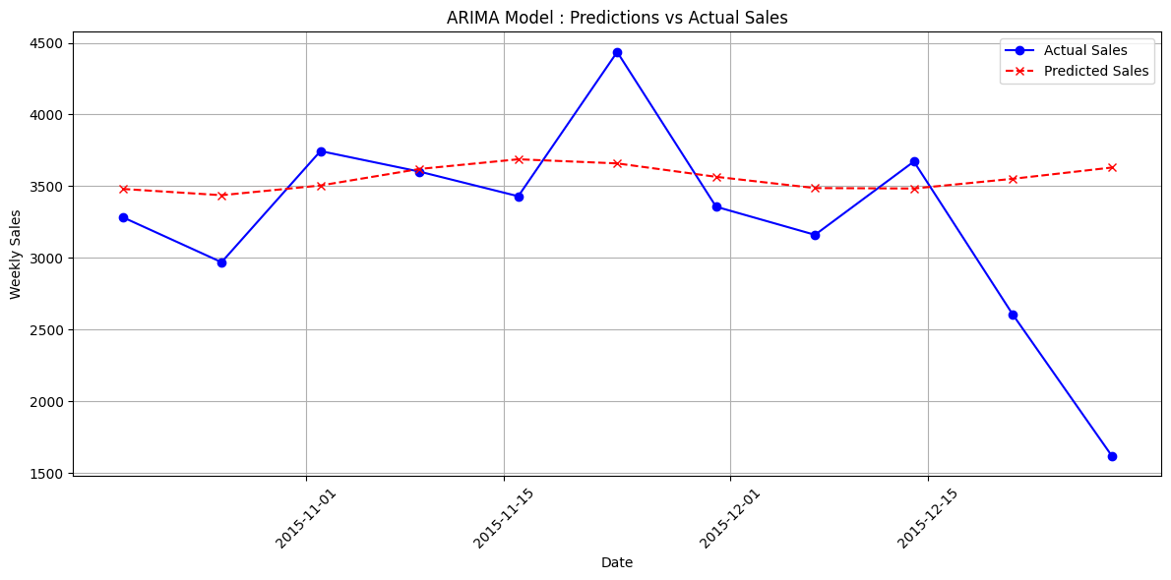
Predictions:
——————
order_date
2015-10-19 3319.775878
2015-10-26 3375.773486
2015-11-02 3595.293288
2015-11-09 3620.336190
2015-11-16 3575.762606
2015-11-23 3457.865741
2015-11-30 3522.849250
2015-12-07 3567.981969
2015-12-14 3560.283906
2015-12-21 3528.769230
2015-12-28 3519.588191
Step 6: Visualization: The plot provides a clear comparison of ARIMA's performance in predicting sales trends.

Slide 26
Model Development
2) SARIMA Model
P (Seasonal AutoRegressive term): The number of past seasonal values used for prediction.
D (Seasonal Differencing term): The number of seasonal differencing applied to make data stationary.
Q (Seasonal Moving Average term): The number of past seasonal forecast errors used for prediction.
S (Seasonal Period): The length of the seasonal cycle (e.g., 12 for yearly seasonality in monthly data).
Implementation:
Step 1: Prepare Weekly Sales Data
Converted order_date to a datetime format.
Use groupby to sum up weekly sales, indexed by the start of each week.
This resulted in a time series dataset (pizza_sales_weekly) where each row represents total weekly sales.
Step 2: Train-Test Split
Split the weekly sales data into train (80%) and test (20%) sets to evaluate model performance.

Slide 27
STEP 3: Define MAPE
Evaluate the accuracy of predictions using Mean Absolute Percentage Error (MAPE).
STEP 4: SARIMA Model Training
Train a SARIMA model using pre-defined parameters and make predictions.
Seasonal ARIMA configuration: order=(1,1,1), seasonal_order=(1,1,1,7)
The seasonal order specifies weekly seasonality (7-day periodicity)
The model is fitted to the training data.
STEP 5: Evaluate SARIMA Model
Predictions: SARIMA model forecasts for weekly sales.
MAPE Score: Quantifies the model’s accuracy.
STEP 6: Visualization
Plot actual sales (blue line with markers), predicted sales (red dashed line with markers).
The plot illustrates how well the SARIMA model forecasts weekly sales trends.

Slide 28
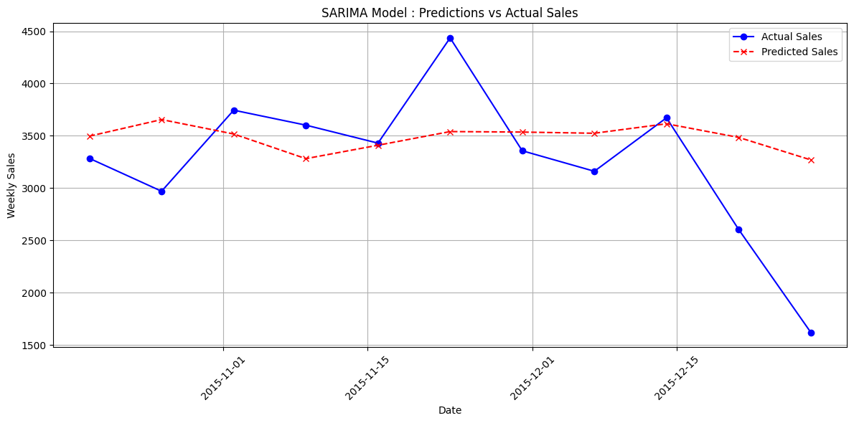
Best SARIMA Model MAPE: 0.1675
Predictions:
——————
order_date predicted_sale
2015-10-19 3467.898918
2015-10-26 3821.591976
2015-11-02 3661.079357
2015-11-09 3362.452422
2015-11-16 3588.727411
2015-11-23 3674.144104
2015-11-30 3697.172848
2015-12-07 3579.600503
2015-12-14 3859.365867
2015-12-21 3712.910737
2015-12-28 3421.524092

Slide 29
Model Development
3) PROPHET Model
Prophet is a popular model for handling time series data with seasonal and holiday effects. The Facebook Prophet model is a tool developed by Facebook for forecasting time series data. It’s especially useful when you want to predict future values based on historical data, such as sales, temperatures, or website traffic.
Growth: Defines the trend type (linear or logistic).
Changepoints: Points where the trend changes.
Seasonality: Models seasonal patterns (weekly, yearly, etc.).
Holidays: Incorporates custom holidays or events affecting the forecast.
Seasonality Mode: Can be additive or multiplicative.
Advantages of Prophet
Handles Missing Data: Works well even with irregular time series or missing data.
Customizability: Supports custom seasonality and holidays.
User-Friendly: Requires minimal parameter tuning.
Automatic Changepoint Detection: Adjusts for trend changes without manual intervention.

Slide 30
Key Features
Growth: Defines the type of trend:
Linear: Assumes a steady growth rate.
Logistic: Assumes growth saturates at an upper limit (requires a cap value).
Changepoints:
Automatic or user-defined points where the trend shifts.
Helps the model adjust for significant changes in the trend.
Seasonality:
Captures recurring patterns (e.g., weekly, yearly).
Custom seasonality (e.g., monthly or quarterly) can also be added.
Holidays:
Lets you specify important dates/events that influence the data.
Accounts for variations caused by holidays or other special occasions.
Seasonality Mode:
Additive: Seasonal effects are constant over time.
Multiplicative: Seasonal effects grow with the level of the trend.

Slide 31
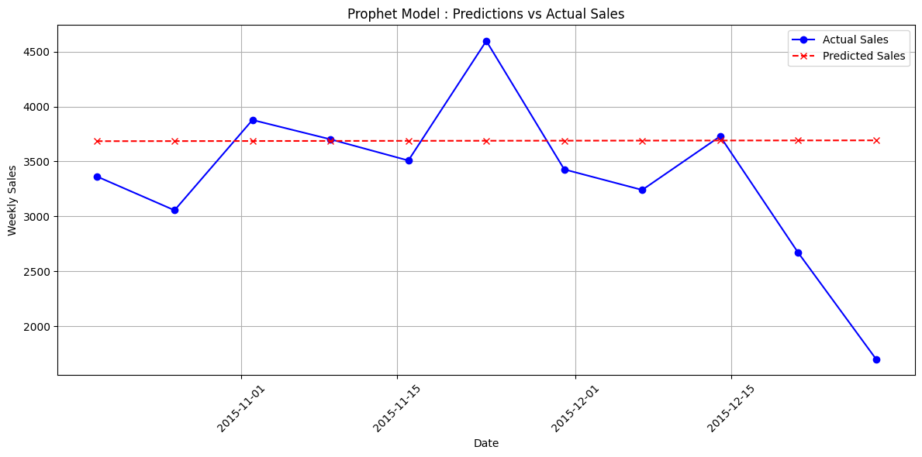
Selected the Prophet Model:
Assign variable name ‘ds’ (order date) as input feature and ‘y’ (quantity) as target to train model.
Split Train set (80%) and Test set (20%) of data and train the model for weekly sales.
Best Prophet Model MAPE: 0.2163
Predictions:
ds(order date) y (quantity)
2015-10-19 3684.955697
2015-10-26 3685.691317
2015-11-02 3686.426937
2015-11-09 3687.162557
2015-11-16 3687.898177
2015-11-23 3688.633796
2015-11-30 3689.369416
2015-12-07 3690.105036
2015-12-14 3690.840656
2015-12-21 3691.576276
2015-12-28 3692.311896

Slide 32
Model Development
4) Regression Model:
Regression model is used to predict future values based on historical data. It helps identify relationships between a dependent variable (target) and one or more independent variables (predictors or features), which may include time-based features like year, month, week, or day.
Weekly Sales Aggregation:
Sales data is aggregated into weekly sales using the order_date column, converting it into start_of_week for each week and summing the quantities.
Feature Extraction:
New features like week_of_year, day_of_week, month, and year are created to capture seasonal patterns and trends in the sales data.
Model Training:
A linear regression model is trained using these features, and its performance is evaluated using Mean Absolute Percentage Error (MAPE) to assess prediction accuracy.

Slide 33
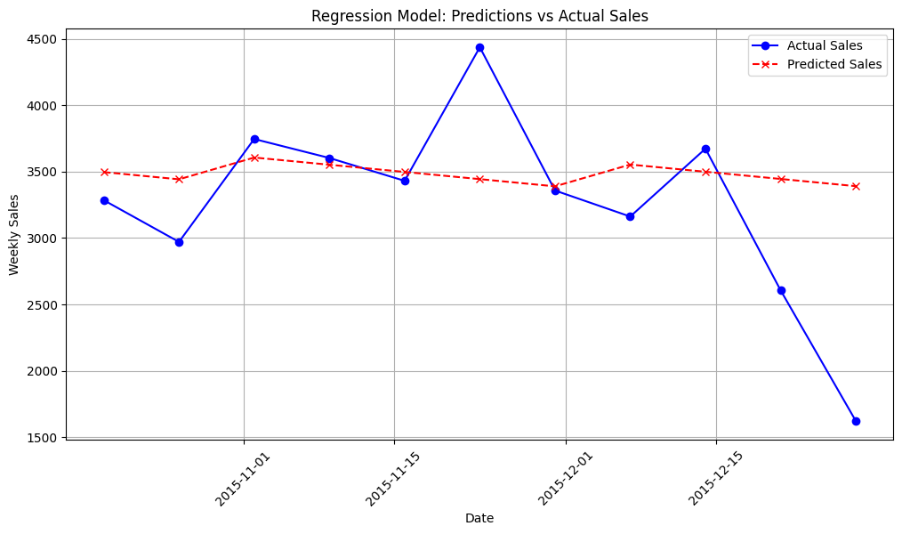
Best Regression Model MAPE: 0.1920
Predictions:
start_of_week
2015-10-19 3495.667443
2015-10-26 3441.427560
2015-11-02 3605.441068
2015-11-09 3551.201185
2015-11-16 3496.961302
2015-11-23 3442.721419
2015-11-30 3388.481536
2015-12-07 3552.495044
2015-12-14 3498.255161
2015-12-21 3444.015278
2015-12-28 3389.775394

Slide 34
Model Development
5) LSTM Model:
LSTM (Long Short-Term Memory) is a type of Recurrent Neural Network (RNN) designed to handle the limitations of traditional RNNs, like the vanishing and exploding gradient problems. Introduced by Sepp Hochreiter and Jürgen Schmidhuber in 1997, LSTMs are effective for learning long-term dependencies in sequential data.
Key Features:
Memory Cells: Store information over time to remember important data.
Gates:
Forget Gate: Decides what to forget.
Input Gate: Decides what new information to store.
Output Gate: Decides what to output from memory.
Challenges of LSTM: Requires large datasets. Slow training and high computational cost. Prone to overfitting. Hard to tune hyperparameters.
Advantages of LSTM for Time-Series: Captures long-term patterns. Handles complex relationships. Works with variable-length data. Scales well with big data.

Slide 35
LSTM Implementation:
Weekly Sales Aggregation:
Aggregates sales data into weekly totals using the order_date column to prepare for time-series forecasting.
Data Scaling and LSTM Dataset Preparation:
Data is normalized using MinMaxScaler and converted into sequences of inputs (X) and outputs (y) suitable for LSTM, with a time step of 3.
LSTM Model Training:
An LSTM model is trained on the processed data with 50 neurons in the LSTM layer and 1 dense output layer using the Adam optimizer and mean squared error (MSE) as the loss function.
Model Evaluation and Visualization:
The model's performance is evaluated using MAPE, and predictions are plotted against actual weekly sales for visual comparison of the model's accuracy.

Slide 36
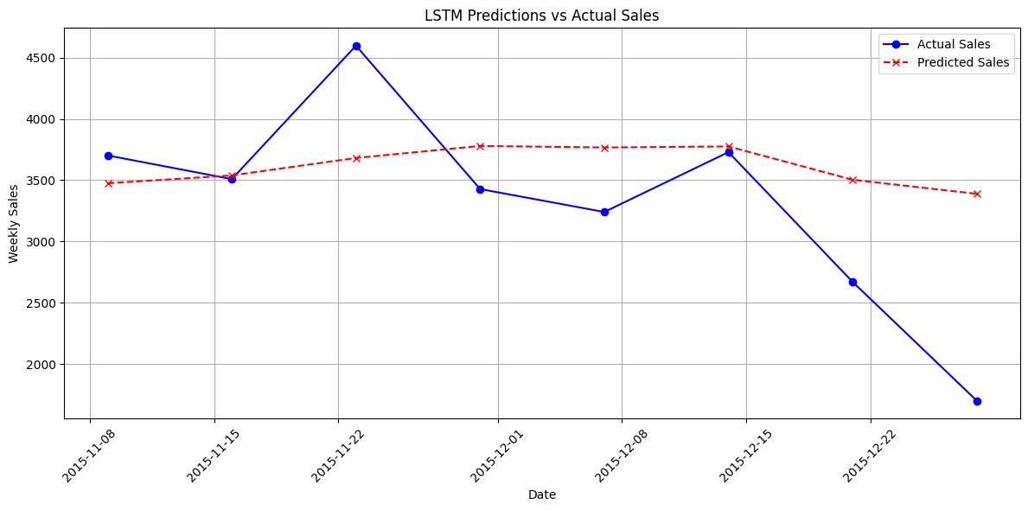
Train the LSTM model with following assigned parameters:
model = Sequential(), neurons=50, activation='relu, epochs=50, batch_size=32, optimizer='adam', loss='mse'
Best LSTM Model MAPE: 0.2394
Predictions:
start_of_week
2015-10-19 3495.667443
2015-10-26 3441.427560
2015-11-02 3605.441068
2015-11-09 3551.201185
2015-11-16 3496.961302
2015-11-23 3442.721419
2015-11-30 3388.481536
2015-12-07 3552.495044
2015-12-14 3498.255161
2015-12-21 3444.015278
2015-12-28 3389.775394

Slide 37
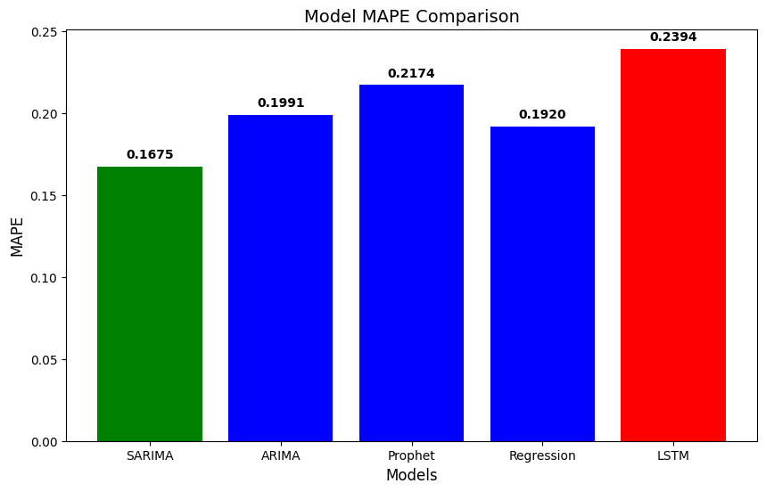
Performance comparison of models
SARIMA performed the best with the lowest MAPE, while LSTM had the highest MAPE, making it the worst model in this comparison.

Slide 38
Purchase Order Creation
Data Preparation:
Sales Data: Loaded from sales.csv and ingredients.csv. The order_date is parsed into datetime format using a custom function to handle various formats.
Sales Aggregation: Data aggregated weekly by pizza type and order date, followed by pivoting to create a summary of sales quantities per pizza type.
Modeling (SARIMA):
SARIMA Model: A SARIMA model was fit to the sales data for each pizza type, with parameters (1, 1, 0) for ARIMA and (1, 1, 0, 7) for seasonal components.
Forecasting: A 7-day forecast for pizza sales was generated for each pizza type.
Ingredient Calculation:
Ingredient Quantities: For each pizza, the ingredients and their required quantities (in grams) are computed based on forecasted pizza sales. This is stored in a dictionary and converted into a DataFrame.
Purchase Order Creation:
A purchase order is created from the ingredient requirements, with the quantity in grams. The purchase order includes ingredient names, quantities, and units of measure.
Output: A table displaying the purchase order, showing required ingredient quantities for the next 7 days based on sales forecasts. This table can be printed or saved as a .csv file for procurement purposes.

Slide 39
Purchase Order:
—--------------
Ingredients quantity unit
Barbecued Chicken 5554.579650 grams
Red Peppers 11192.015949 grams
Green Peppers 7683.637506 grams
Tomatoes 29914.962419 grams
Red Onions 44887.814993 grams
Barbecue Sauce 1851.526550 grams
Bacon 18995.910759 grams
Pepperoni 22477.214206 grams
Italian Sausage 338.721110 grams
Chorizo Sausage 1693.605548 grams
Brie Carre Cheese 118.646399 grams
Prosciutto 118.646399 grams
Caramelized Onions 63.278080 grams
Pears 39.548800 grams
Thyme 19.774400 grams
Garlic 15418.184086 grams
?duja Salami 1974.313619 grams
Pancetta 2961.470428 grams
Based on the requirement of ingredients, purchase order is created.

Slide 40
THANK YOU

